Slide 1
Week One

Slide 2
Meditation
Learning Objective:
I can use an exercise of listening and breathing to calm and focus my mind
I will use meditation to deal with upsetting situations
Notes:
Standard:
Essential Concept and/or Skill: Communicate and work productively with others emphasizing collaboration and cultural awareness to produce quality work.
Interact positively as a team member.
Cooperate with others in a group setting.
Generate ideas with group members.
Are active listeners.
Read and understand information in a variety of forms.
Express ideas.
Skill:
Active listening, express ideas

Slide 3
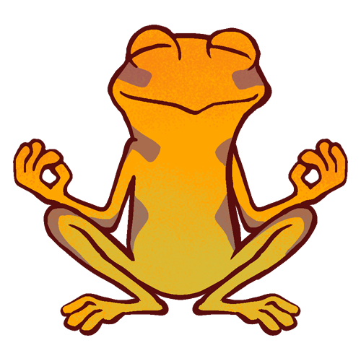
Skills
Self Management
Stress Management

Slide 4
What is mindfulness?

Slide 5
Activity
Today, we are going to focus on a specific type of meditation.
Concentration meditation
This involves focusing on a single point. It could be the regulation of your breath, the sound of the rain or wind blowing against your window, a candle flame or a repetitive gong (If you don’t happen to have a gong in your bedroom, there’s a thing called YouTube). To begin with, it will be tricky (and maybe boring) to concentrate on just one thing when you have a million other thoughts whizzing through your mind. But rather than pursuing random thoughts, you will learn to just let them go, along with the stress and anxiety that comes with it.
This meditation will improve: Stress and concentration AKA no more procrastination

